Slide 1

Introduction
BANK LOAN ANALYSIS
"Welcome to our project focused on analyzing bank loans to drive customer success and unlock new opportunities in the finance domain."

Slide 2


Title: "Bank Loan Analysis
Introduction of Project
Domain : Finance
Project: Bank loan of customers
Datasets: Finance_1.xlsx & Finance_2.xlsx
Dataset Type: Excel Data
Dataset Size: Each Excel file has 39k+ records

Slide 3

ABOUT DATASET
"Our project is based on two comprehensive Excel datasets: Finance_1.xlsx and Finance_2.xlsx. These datasets contain a substantial amount of data, with each Excel file comprising over 39,000 records. They provide us with a rich and diverse set of information to analyze and gain insights from."

Slide 4


project objectives:
Our main goal is to uncover some super useful insights, spot trends, and create key performance indicators (KPIs) that will help us make smarter decisions about our loan portfolio.

Slide 5

problem statements:
1)Understanding Year-wise Loan Amount Statistics:
How has the loan amount disbursed by our bank changed over the years?
2)Grade and Subgrade-wise Revolving Balances:
How does the revolving balance vary across different loan grades and subgrades?
3) Comparing Total Payments for Verified and Non-Verified Status:
What is the difference in total payments made by borrowers with verified and non-verified statuses?
4) Analyzing Loan Status by State and Last Credit Pull Date:
How does loan status vary across different states and the time of the last credit pull?
5) Examining Home Ownership and Last Payment Date Statistics:
How does home ownership status relate to the time since the last payment?
Are there any differences in payment behavior based on home ownership?

Slide 6

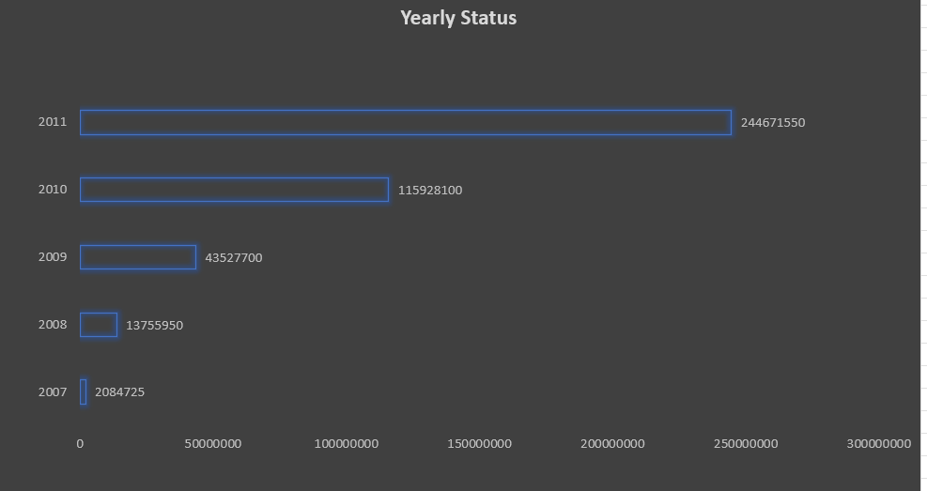
KPI_1: YEAR WISE LOAN AMOUNT STATUS

Slide 7
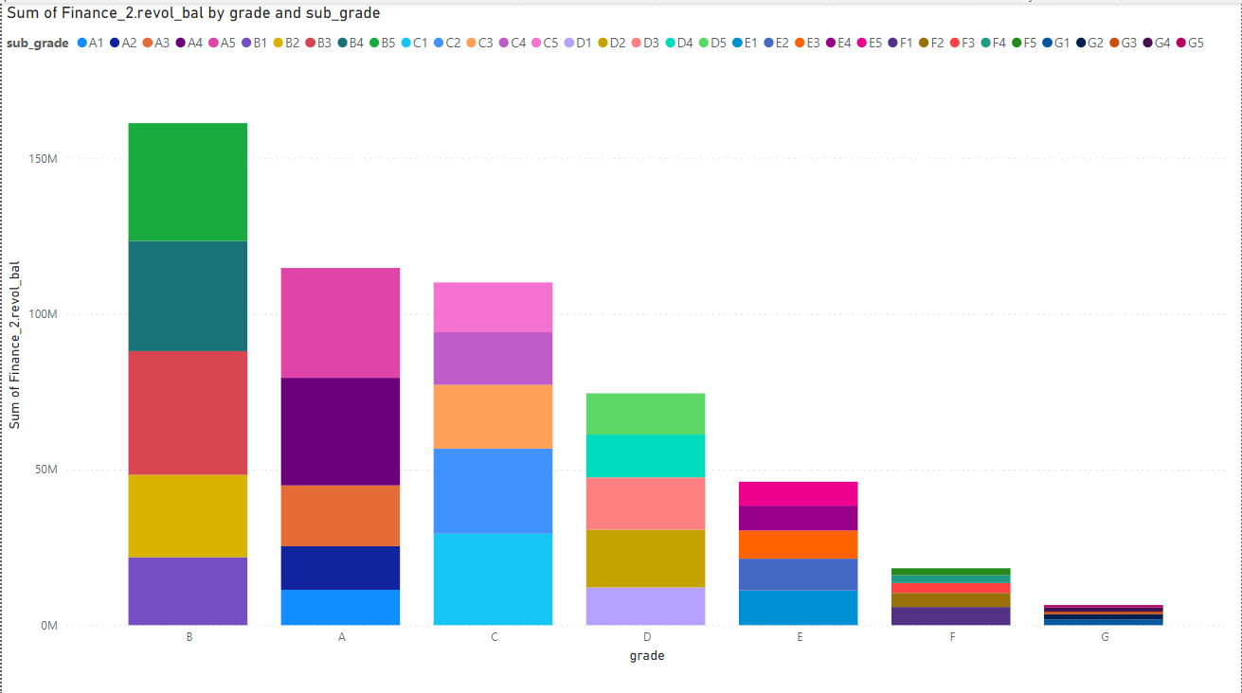
KPI_2: GRADE AND SUB-GRADE WISE REVOL_BALANCE

Slide 8
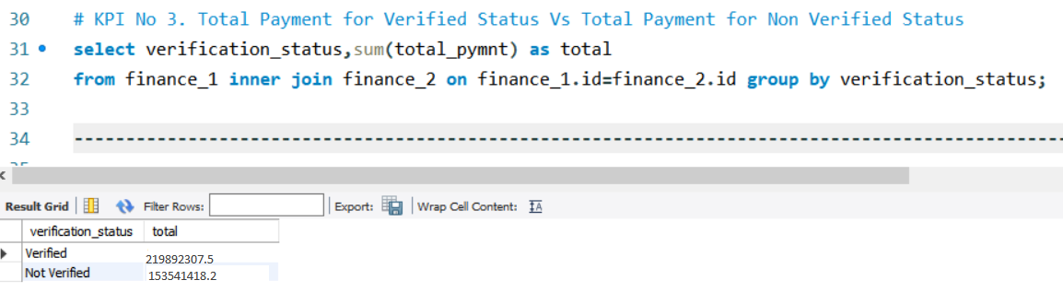
KPI_3: TOTAL AMOUNT FOR VERIFIED VS NON VERIFIED STATUS

Slide 9
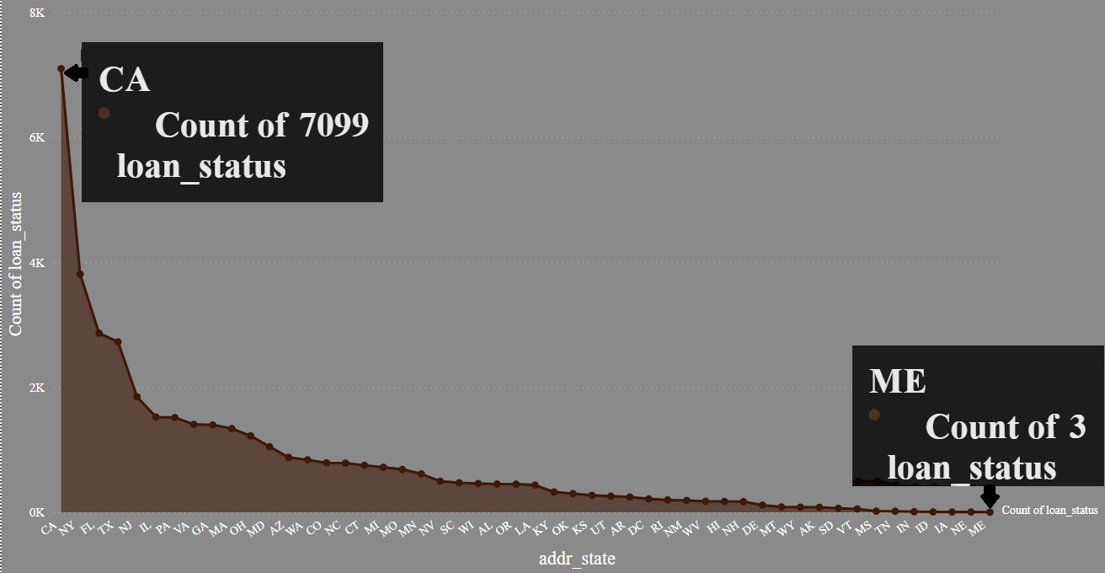
KPI_4: STATE WISE AND LAST CREDIT PULL WISE LOAN STATUS

Slide 10
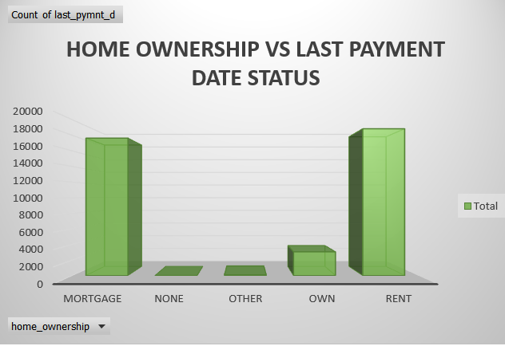
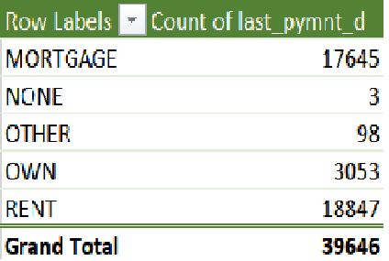
KPI_5: HOME OWNERSHIP VS LAST PAYMENT STATUS

Slide 11
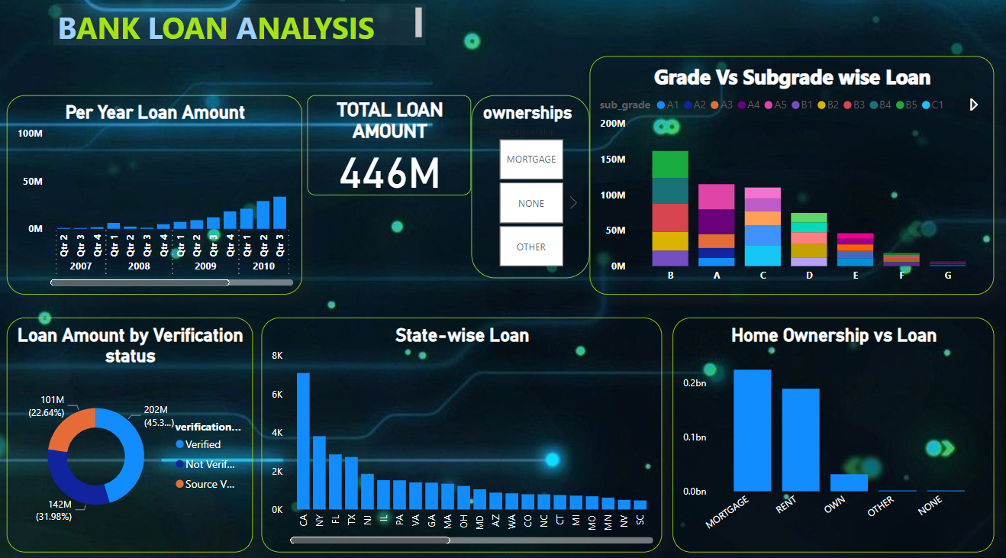

Slide 12


